Slide 1

Welcome!
Grab a drink, food, and chat with your fellow makers.
January 24, 2017

Slide 2

What is Open Hardware?
Open (Source) Hardware, or OSHW, is “hardware whose design is made publicly available so that anyone can study, modify, distribute, make, and sell the design or hardware based on that design.”

Slide 3
Introductions
Name
Day Job or other
Open Hardware Experience
What did you work on over the holidays

Slide 4
Project presentations:
Ground rules:
No “Um, actually…”
No ‘Mock Surprise’
Money talk not required
Be ok with “I’ll get to that”

Slide 5
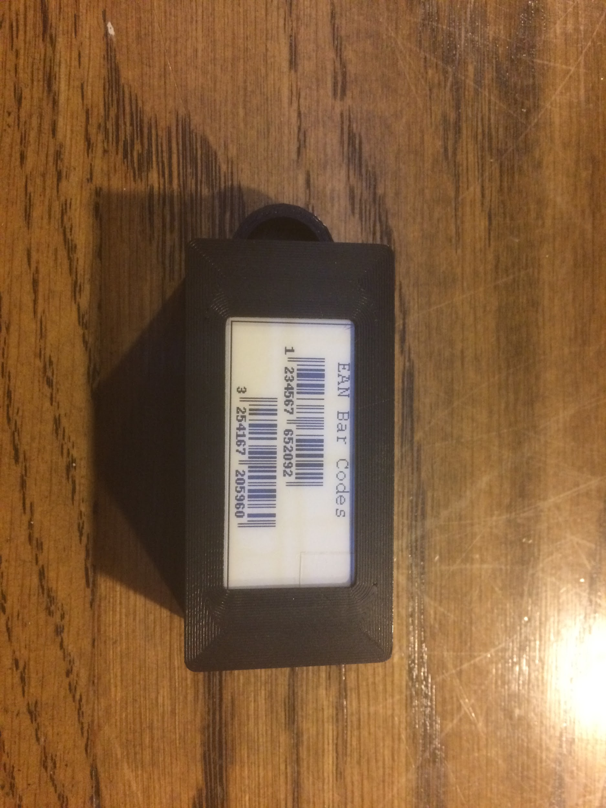
Presentation: Fobbi

Slide 6
Fobbi
Idea started Fall ‘13
Replaces keychain full of loyalty cards
Less clutter on keychain
Readable by all scanners - eInk/ePaper Display
Quicker then pulling up an app - location aware
Won “Startup Weekend: South Bend” and pitched investors
Backburner since

Slide 7
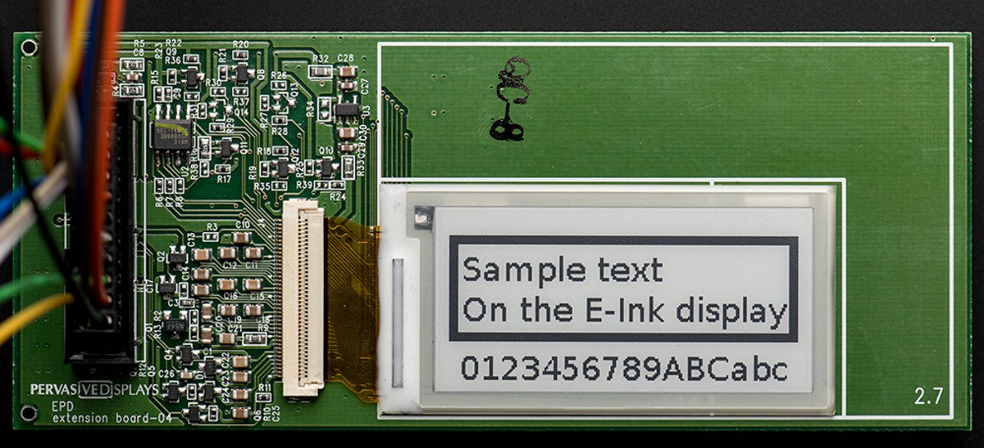
Fobbi

Slide 8
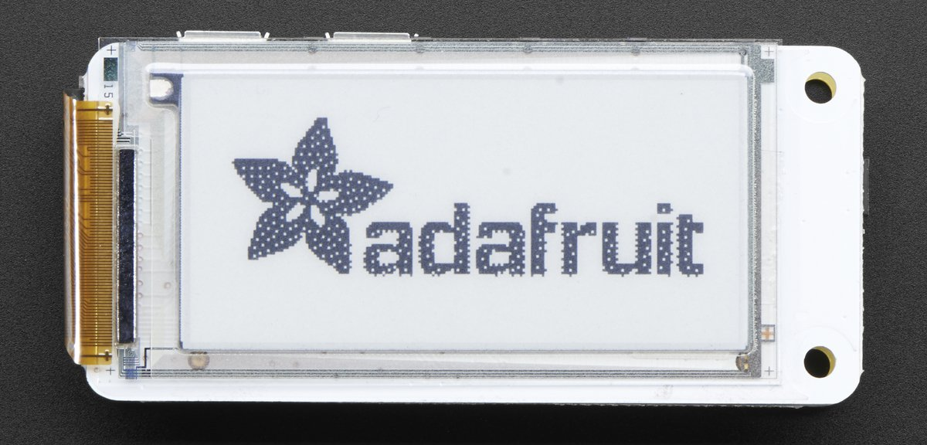
Fobbi

Slide 9
Fobbi
Goals:
Compact Design
Off-the-shelf components
Anyone could make (plug-n-play)

Slide 10
Fobbi
Main Components:
Raspberry Pi Zero
Papirus ePaper pHAT
Redbear IoT pHAT
Additional:
4 GB MicroSD
PowerBoost 1000C
LiPo Battery 350 mAh
Case

Slide 11
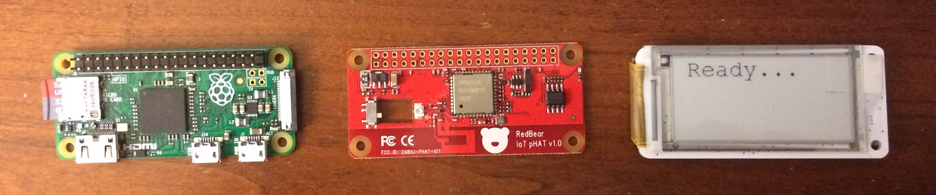
Fobbi
Pi Zero RedBear IoT pHAT Papirus ePaper pHAT

Slide 12
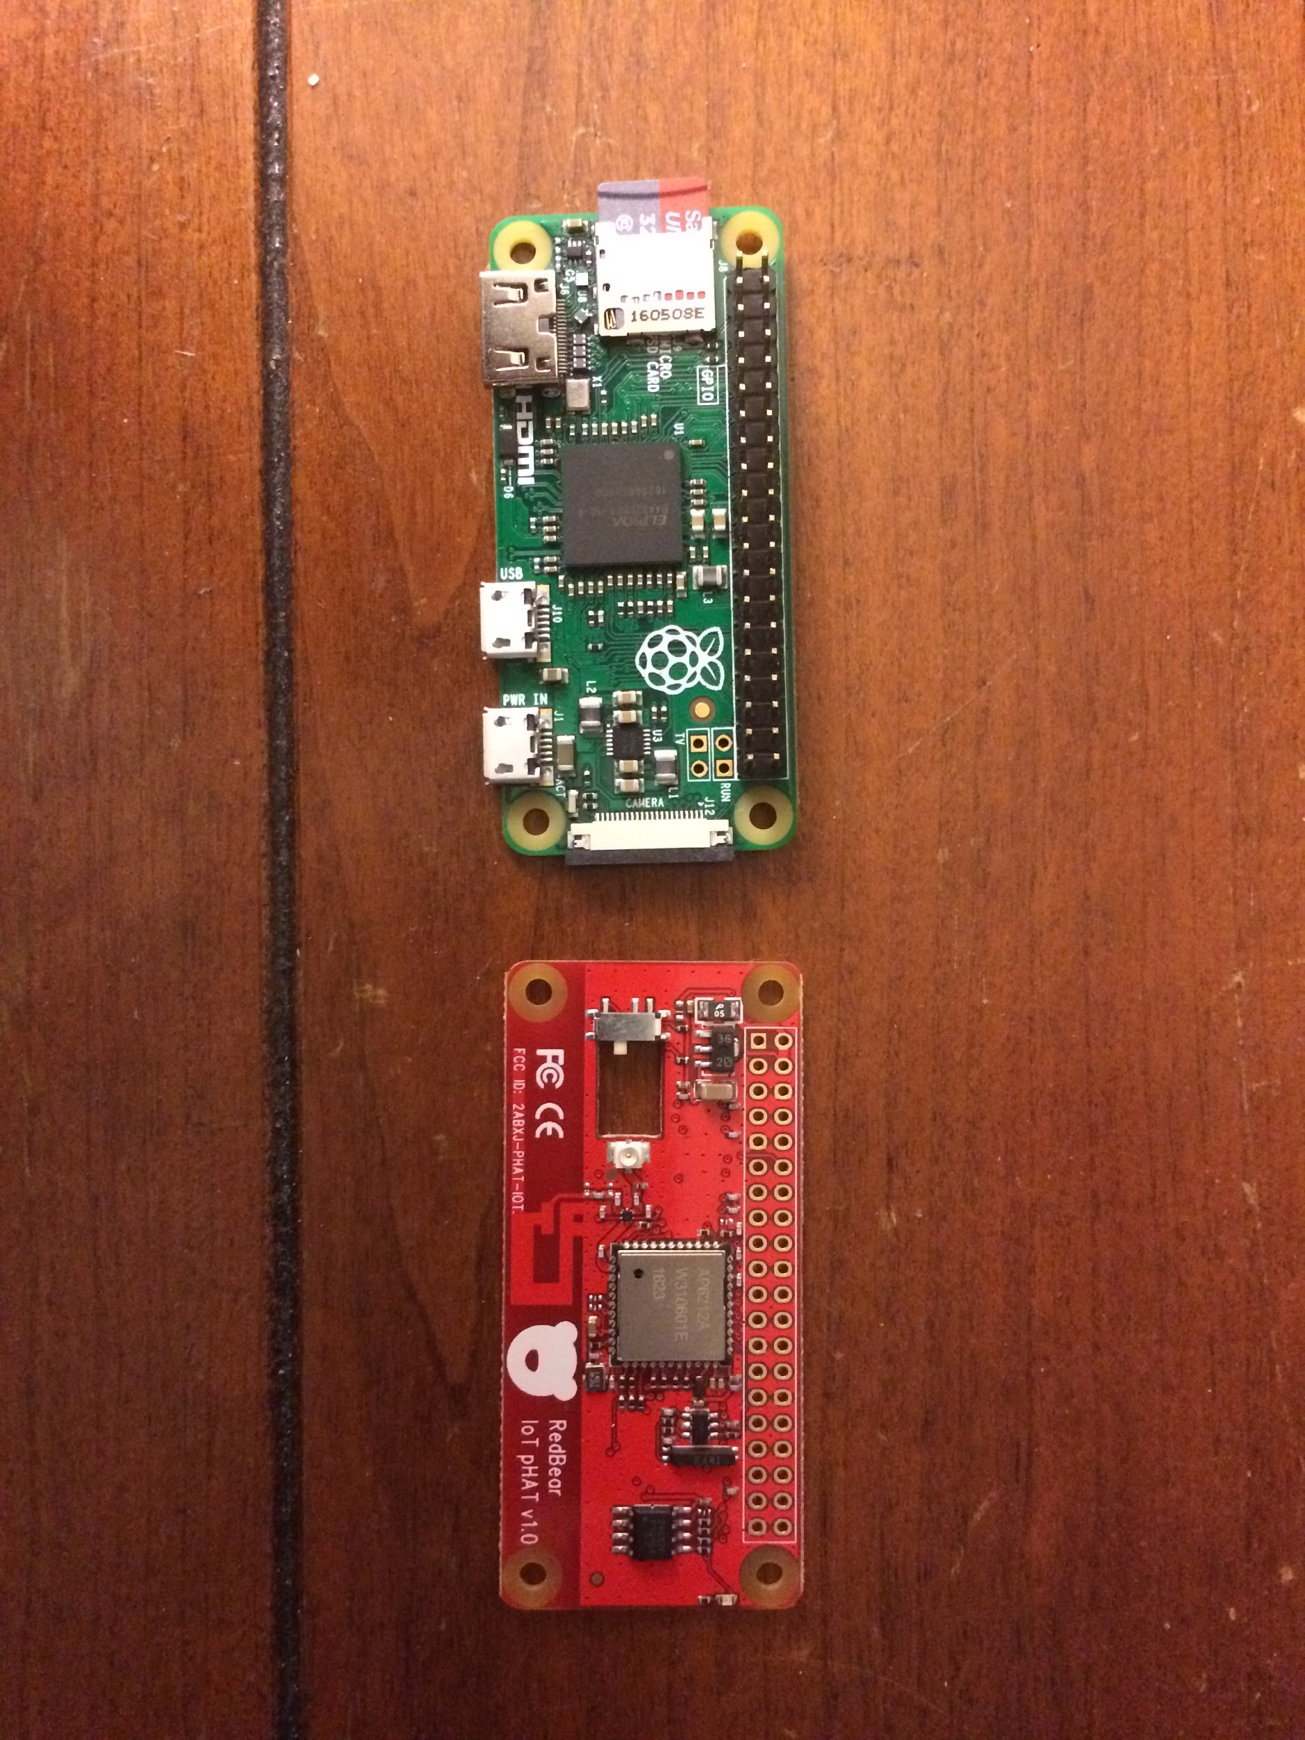
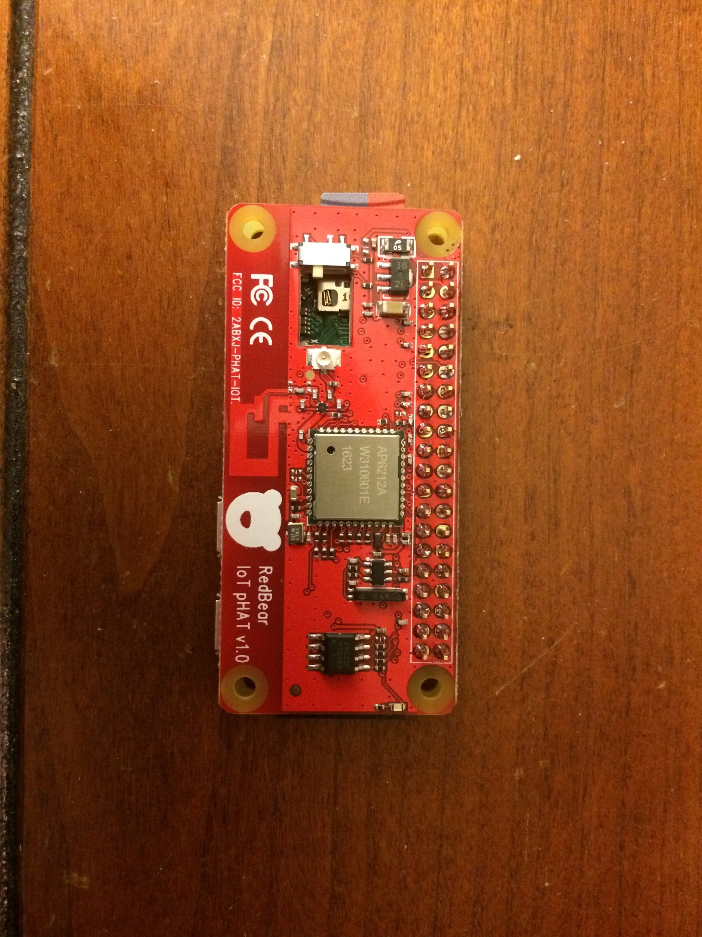
Fobbi

Slide 13
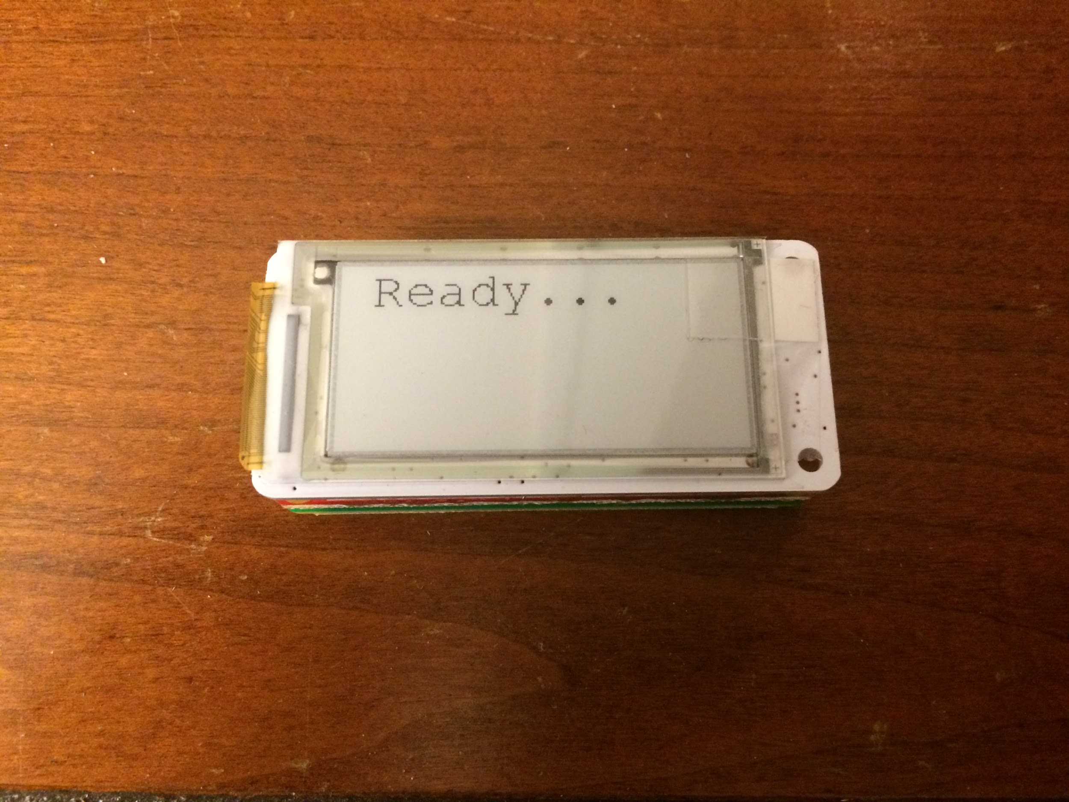
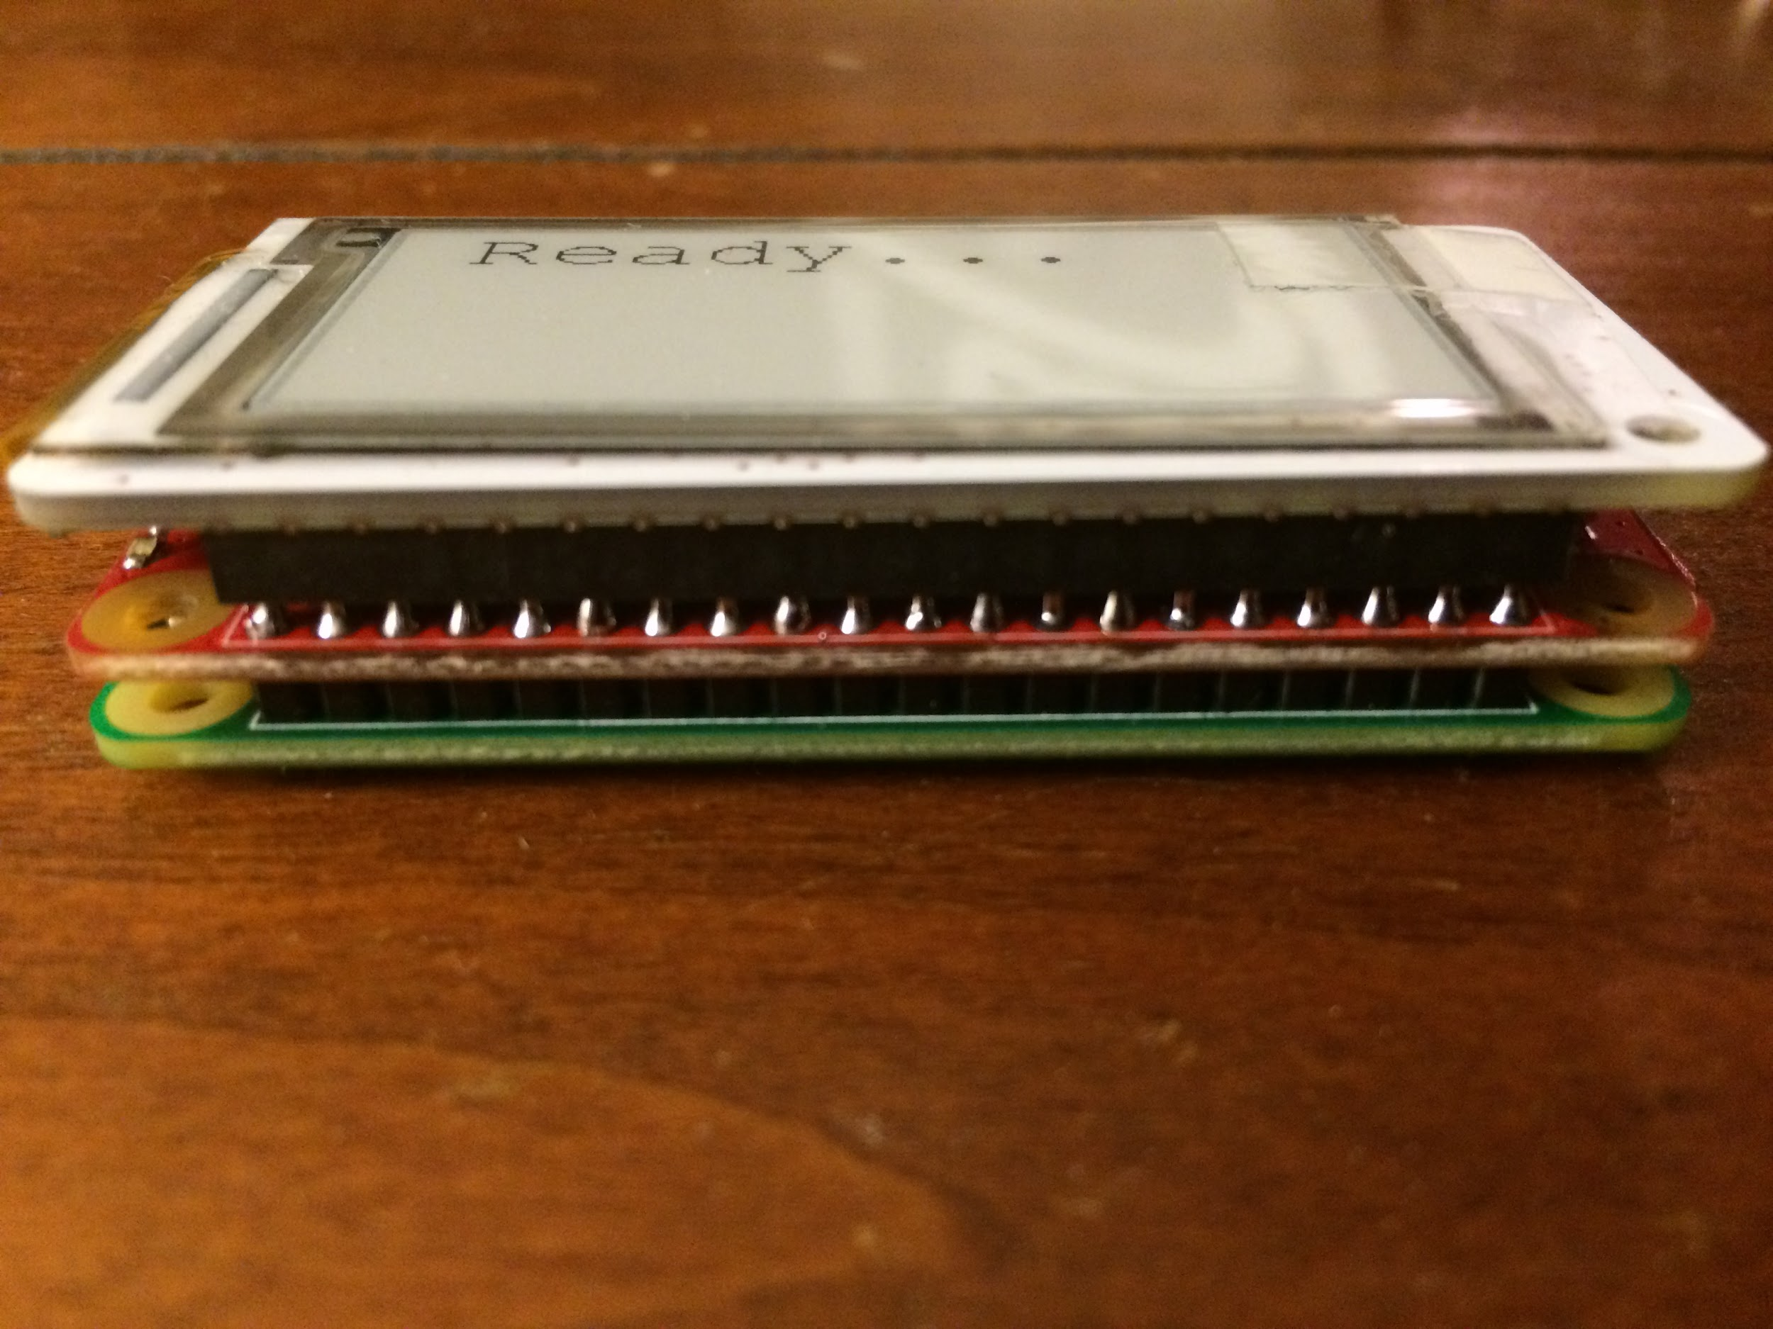
Fobbi

Slide 14
Fobbi
Fail

Slide 15
Fobbi
Problem: Raspberry Pi hats should not be stacked
Reason: They use the same pins, specifically the dedicated I2C for the EEPROM
Solution: The Papirus pHAT is not a real hat. Doesn’t have EEPROM. Rewire!

Slide 16
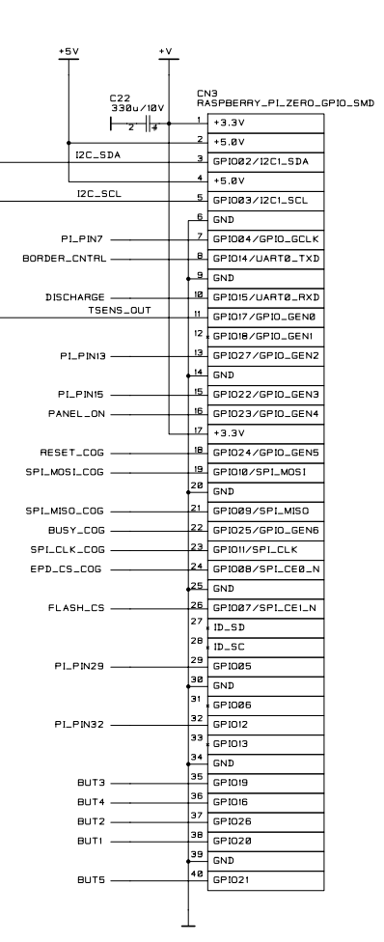
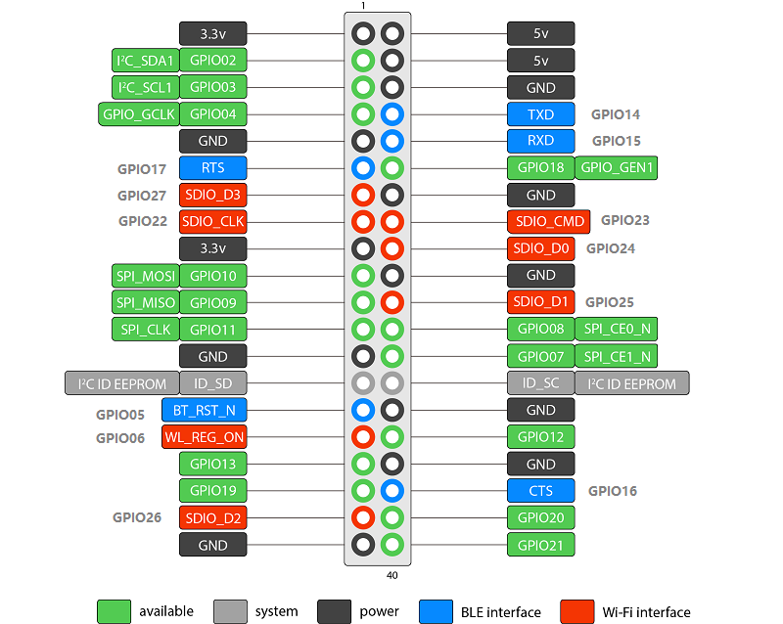
Fobbi

Slide 17
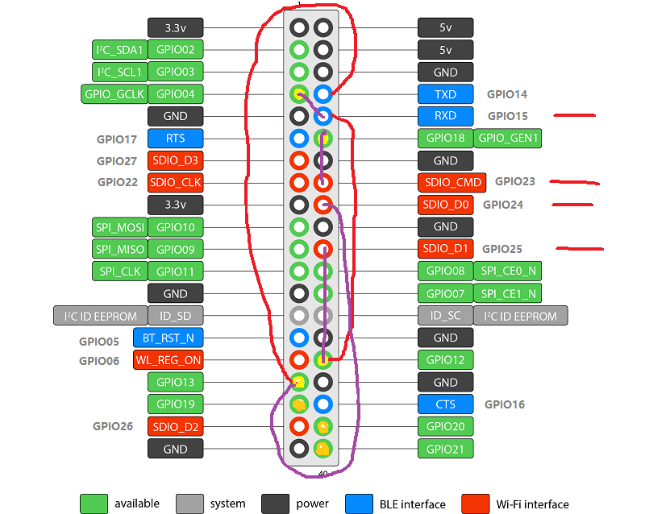
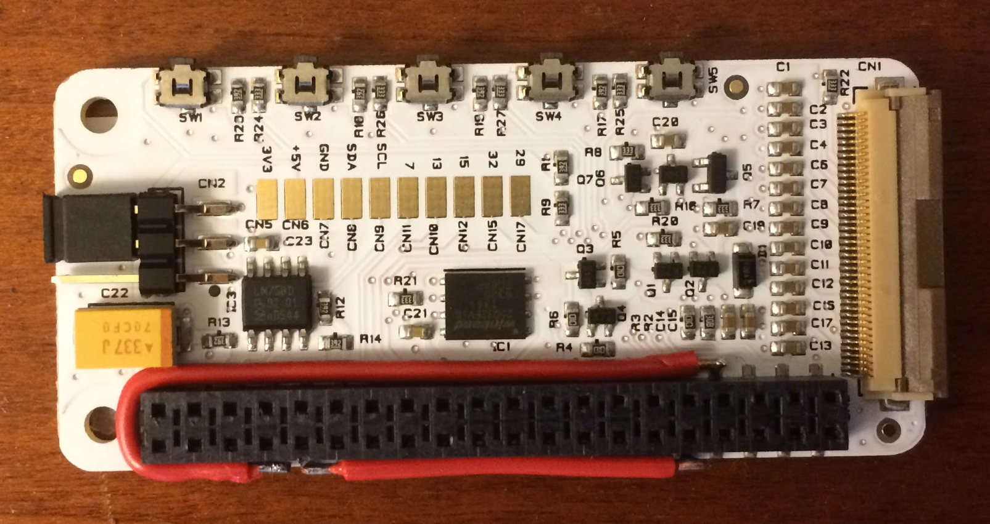
Fobbi

Slide 18
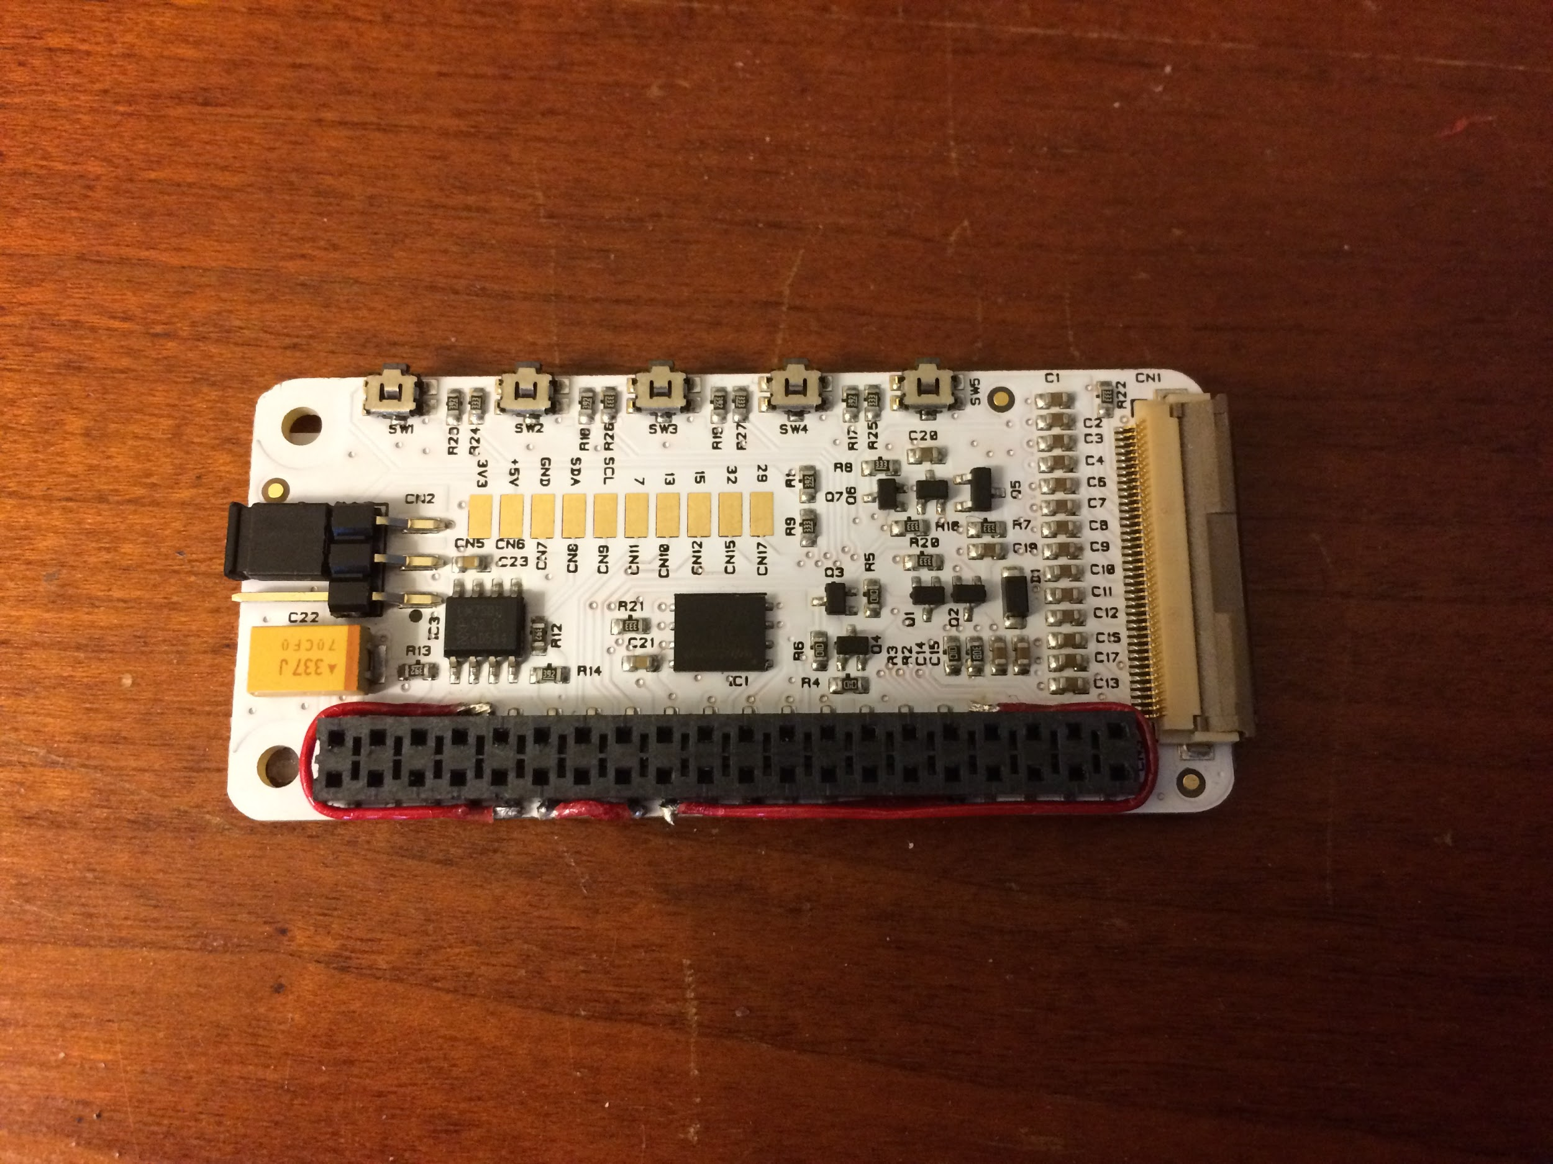
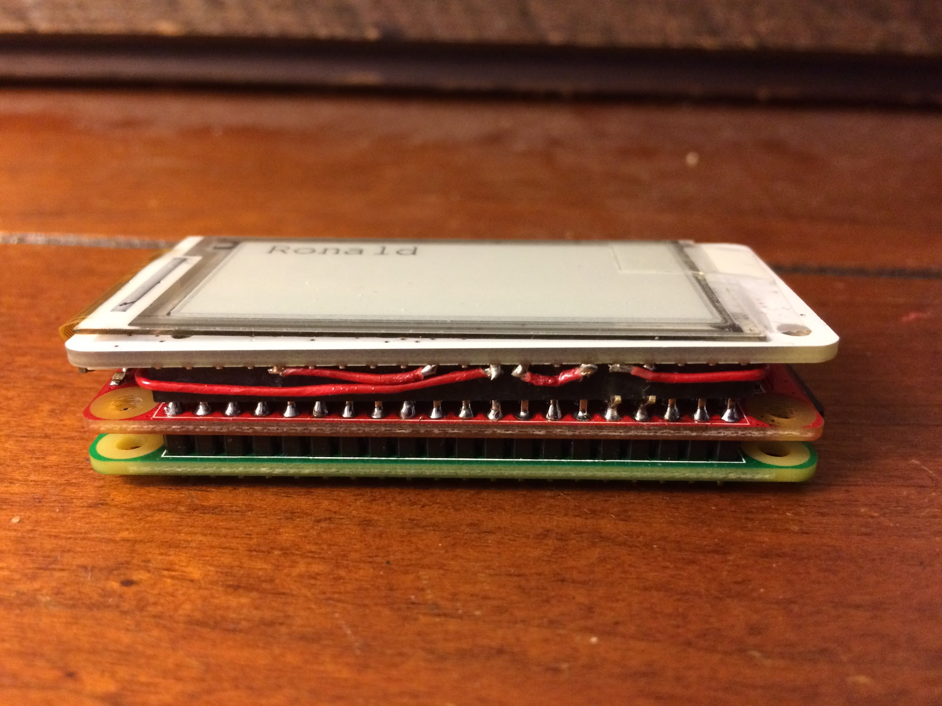
Fobbi

Slide 19
Fobbi
Snip re-routed pins
Install Jesse Lite on SD card
Connect and Update
Install software

Slide 20
Fobbi
Install Jesse Lite on SD card
Diskpart
Fedora Arm Installer vs Etcher vs Win32DiskImager
Copy ssh & wpa_supplicant.conf

Slide 21
Fobbi
Connect and Update
SSH using Putty (raspberrypi.local port 22)
sudo raspi-config: expand file system, reboot
sudo apt-get update && sudo apt-get upgrade -y, reboot
git clone https://github.com/PiSupply/PaPiRus.git
git clone https://github.com/repaper/gratis.git
Before installing change pin definitions

Slide 22
Fobbi
Connect and Update cont.
cd gratis/PlatformWithOS
git reset --hard ab46fd7
sudo nano RaspberryPi/gpio.h
GPIO_P1_32 = 12,
GPIO_P1_33 = 13,
GPIO_P1_35 = 19,
sudo nano RaspberryPi/epd_io.h
#define panel_on_pin GPIO_P1_12
#define border_pin GPIO_P1_35
#define discharge_pin GPIO_P1_07
#define pwm_pin GPIO_P1_12
#define reset_pin GPIO_P1_33
#define busy_pin GPIO_P1_32

Slide 23
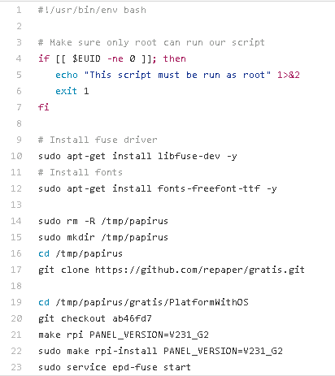
Fobbi
Connect and Update cont.
sudo nano PaPiRus/bin/papirus-setup
Comment line 14,15,16,17,19,20
Add ‘cd /home/pi/gratis/PlatformWithOS’

Slide 24
Fobbi
Install software
cd PaPiRus
sudo python setup.py install
sudo papirus-setup
sudo papirus-config or sudo papirus-set 2.0
Test: sudo papirus-write "Hello World!"
cd gratis/PlatformWithOS/demo/barcode/
PYTHONPATH=.. python BarCodeDemo.py

Slide 25
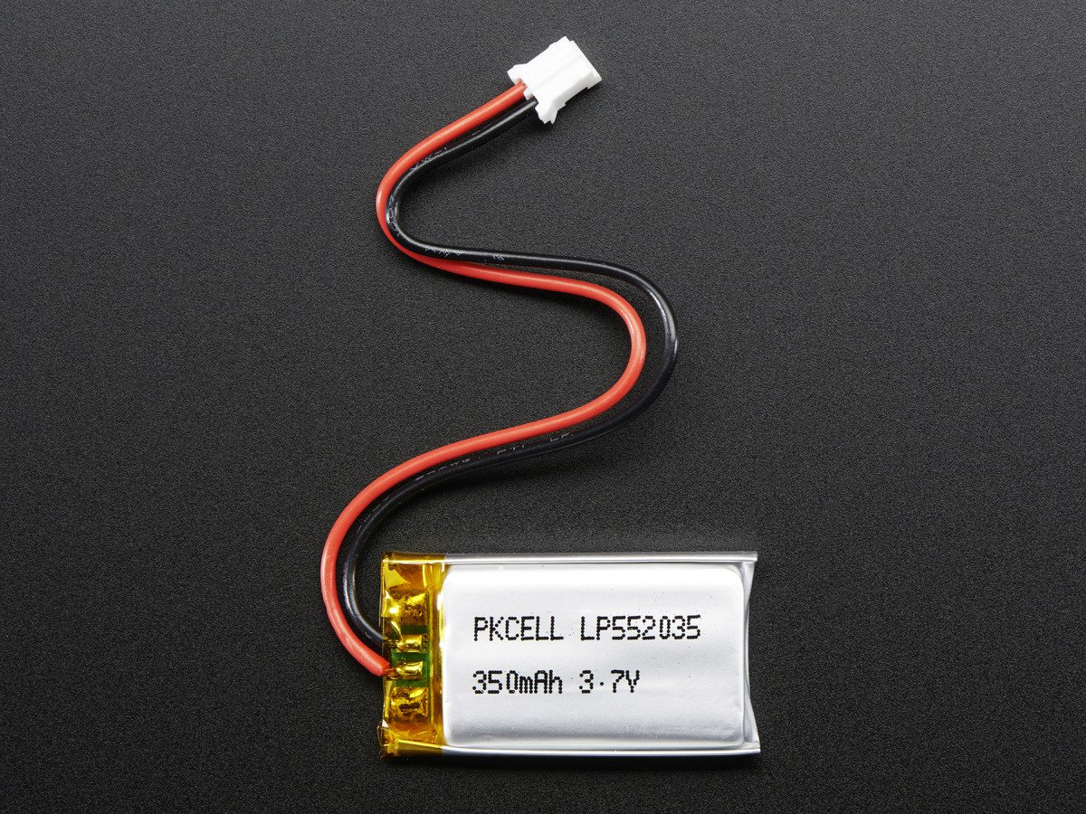
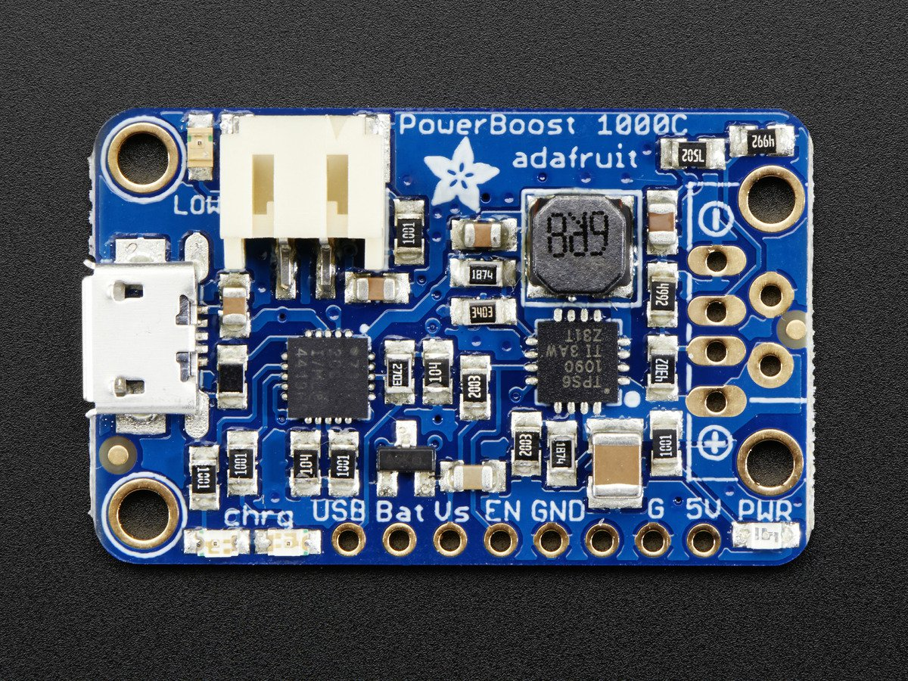
Fobbi
Extra Credit: Power

Slide 26
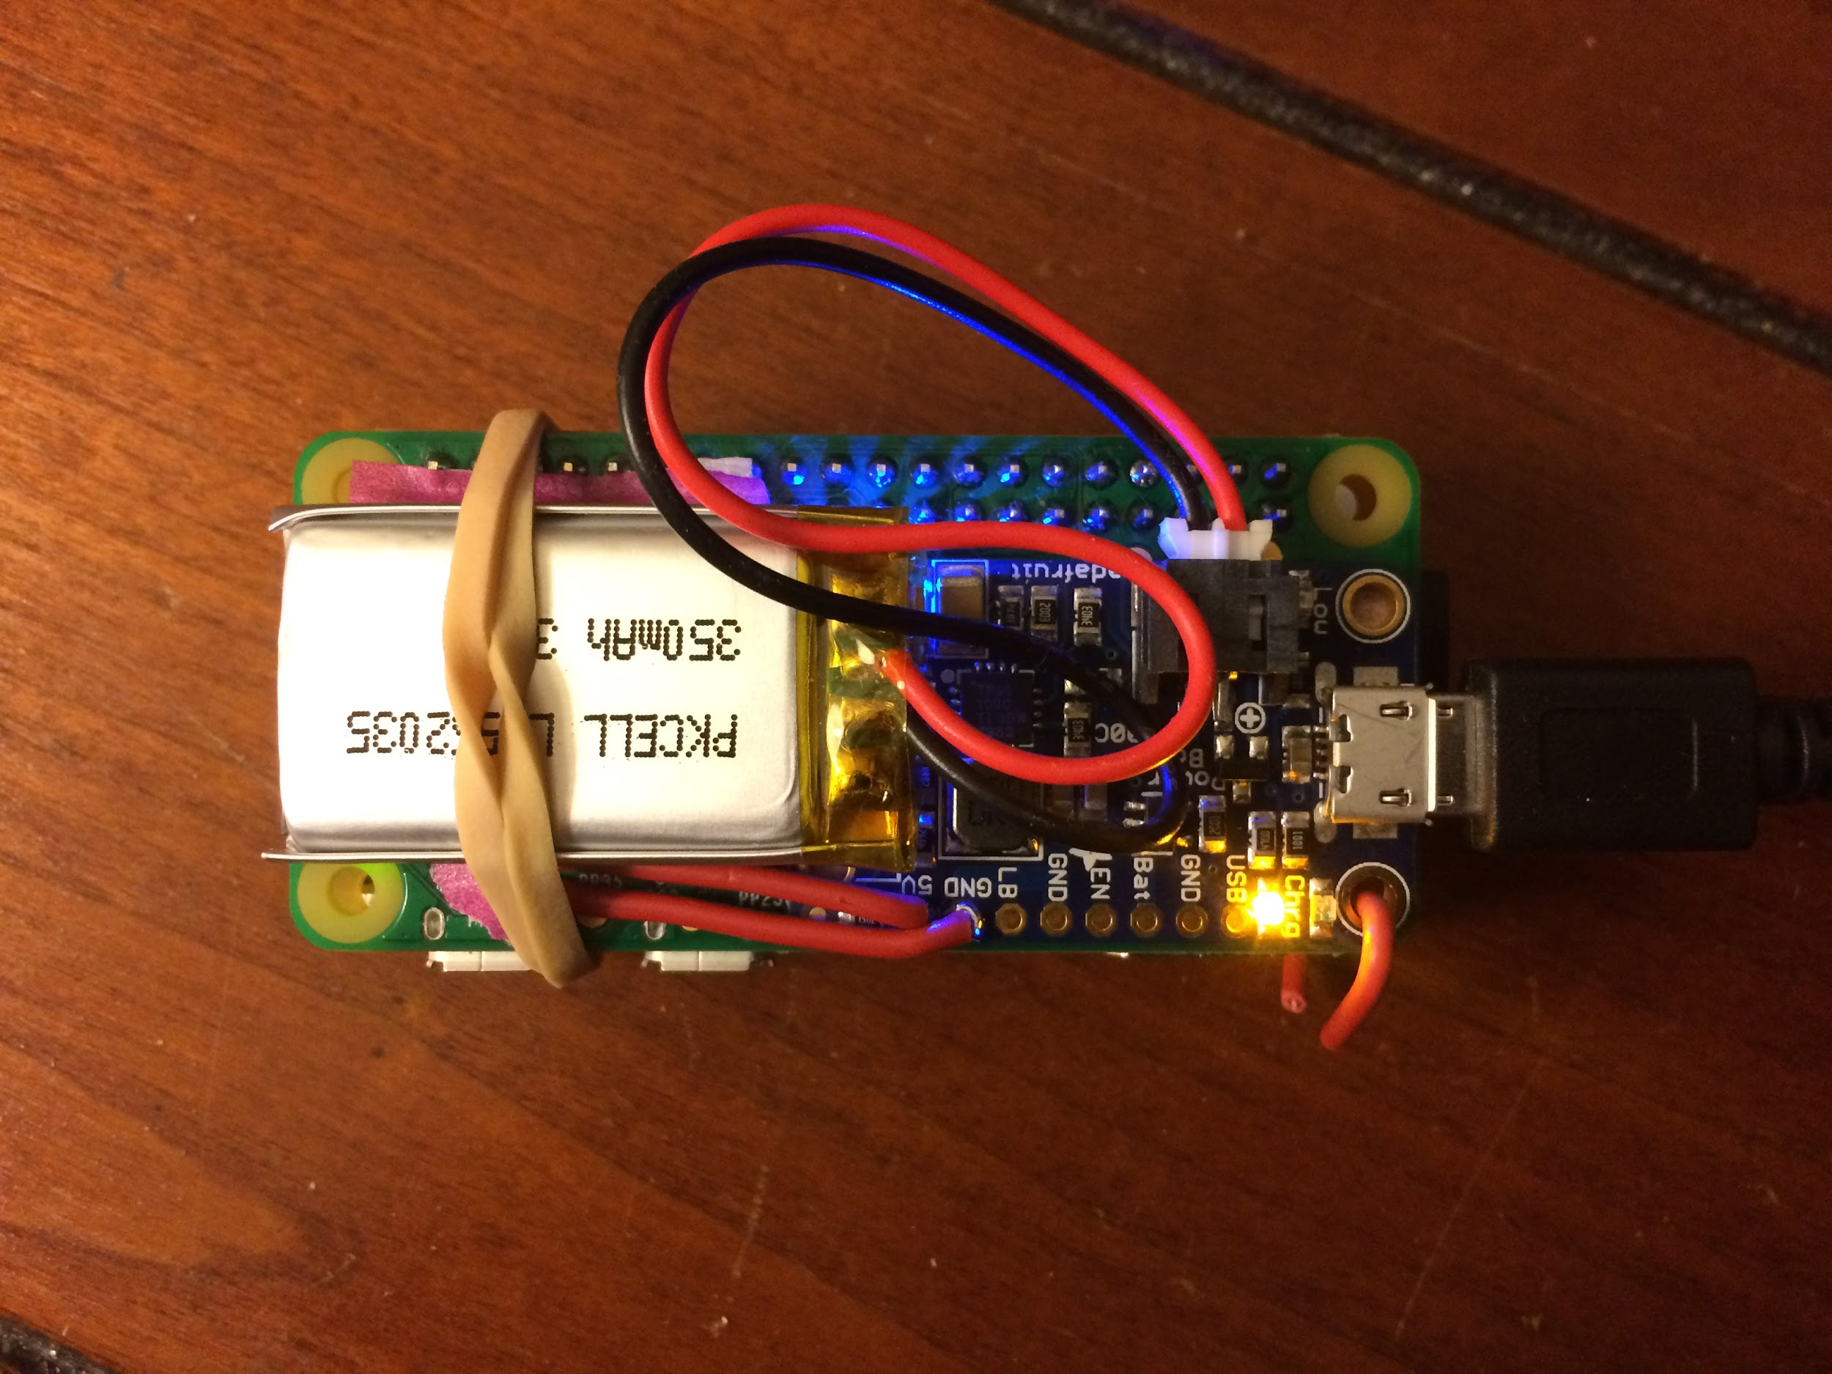
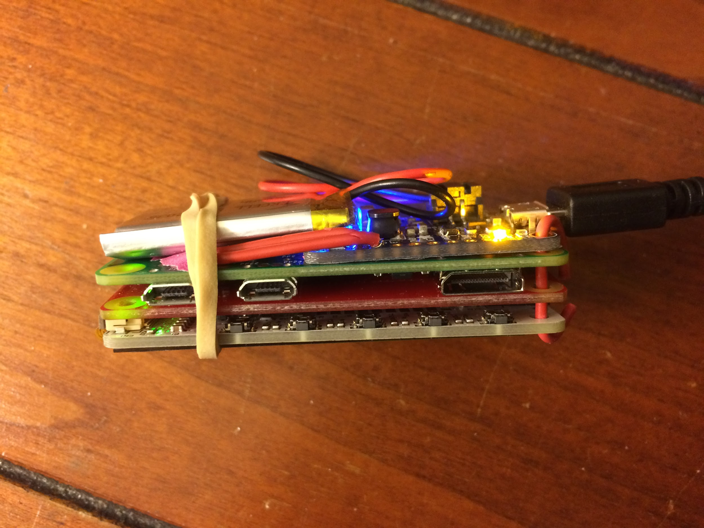
Fobbi
Extra Credit: Power

Slide 27
Fobbi

Slide 28

indyopenhardware@gmail.com
@INOpenHardware
indy-ansible-invite.herokuapp.com/she4ytoexq2uiapnsa0x
meetup.com/Indy-Open-Hardware-Meetup github.com/IndyOpenHardware

